Slide 1
WELCOME TO OUR
PRESENTATION
Aasim Sheraz
Ali Hasan
Fazal Wahab
Khushal Khan Khattak
Rizwan Malik
Tayyab Ayaz
1

Slide 2
Concepts: Preliminary
DBSCAN is a density-based algorithm
DBScan stands for Density-Based Spatial Clustering of Applications with Noise
Density-based Clustering locates regions of high density that are separated from one another by regions of low density
Density = number of points within a specified radius (Eps)

Slide 3
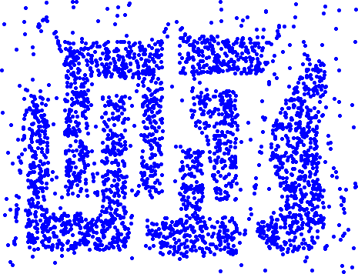
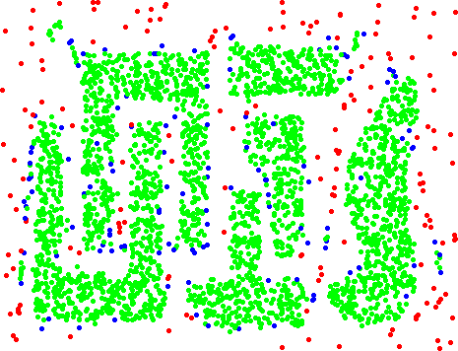
Concepts: Preliminary
Original Points
Point types: core, border
and noise
Eps = 10, MinPts = 4

Slide 4
Concepts: Preliminary
A point is a core point if it has more than a specified number of points (MinPts) within Eps
These are points that are at the interior of a cluster
A border point has fewer than MinPts within Eps, but is in the neighborhood of a core point
A noise point is any point that is not a core point or a border point

Slide 5
Concepts: Preliminary
Any two core points are close enough– within a distance
Eps of one another – are put in the same cluster
Any border point that is close enough to a core point is put in the same cluster as the core point
Noise points are discarded

Slide 6
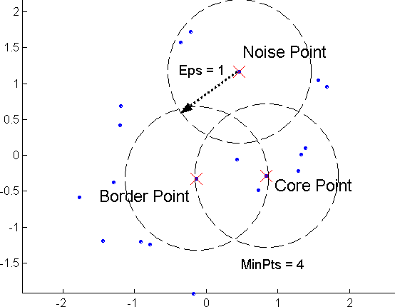
Concepts: Core, Border, Noise

Slide 7
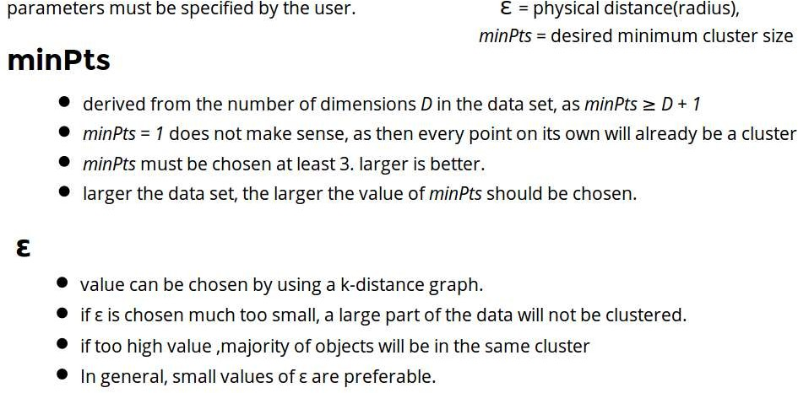
Parameter Estimation

Slide 8












Concepts: ε-Neighborhood
ε-Neighborhood - Objects within a radius of ε from an object. (epsilon-neighborhood)
Core objects - ε-Neighborhood of an object contains at least MinPts of objects
ε-Neighborhood of p
ε-Neighborhood of q
p is a core object (MinPts = 4)
q is not a core object
ε
ε
p
q

Slide 9




DBScan : Reachability
Directly density-reachable
– An object q is directly density-reachable from object p if q is within the ε-Neighborhood of p and p is a core object.
q is directly density- reachable from p
p is not directly density- reachable from q.
ε
ε
p
q

Slide 10
DBScan : Reachability
q
p

Slide 11







DBScan :Connectivity
Density-connectivity
– Object p is density-connected to object q w.r.t ε and MinPts if there is an object o such that both p and q are density-reachable from o w.r.t ε and MinPts
P and q are density- connected to each other by r
Density-connectivity is symmetric
q
r
p

Slide 12
Core, Border, Noise points representation
Original Points
Point types: core, border and noise
Eps = 10, MinPts = 4

Slide 13
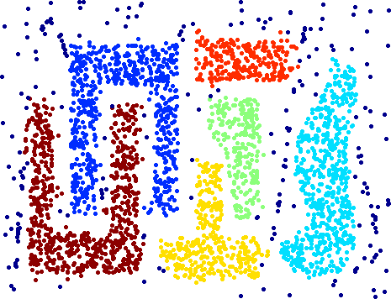
Clustering
Original Points
Clusters
Resistant to Noise
Can handle clusters of different shapes and sizes

Slide 14
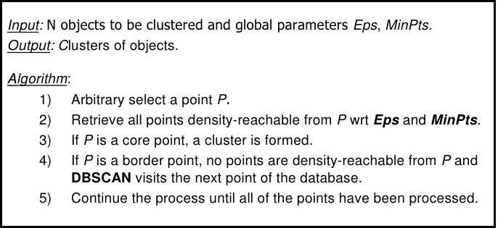
DBScan Algorithm

Slide 15
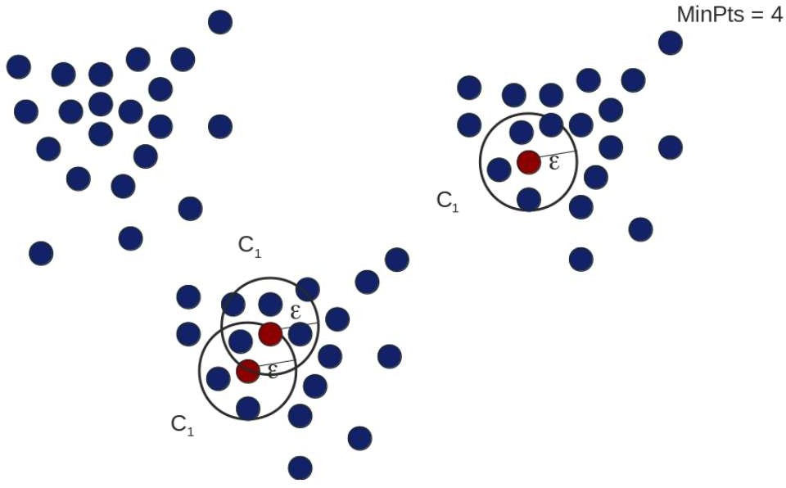
DBScan : Example

Slide 16
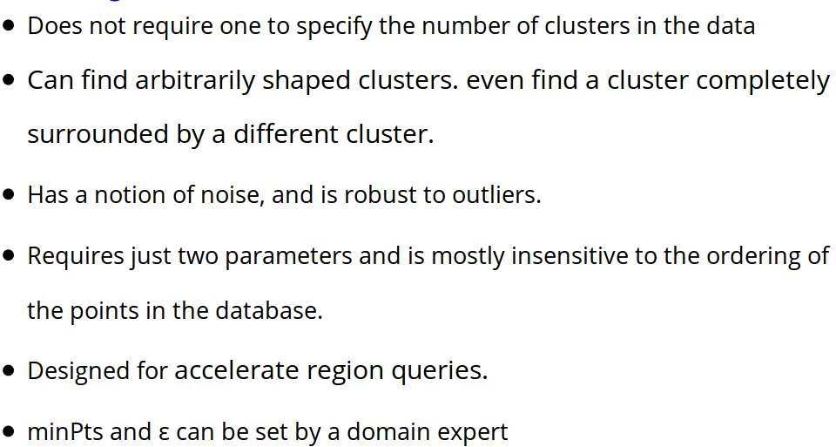
DBSCAN : Advantages

Slide 17
DBSCAN : Disadvantages
DBSCAN is not entirely deterministic: Border points that are reachable from more than one cluster can be part of either cluster, depending on the order the data is processed.
The quality of DBSCAN depends on the distance measure used in the function regionQuery. (such as Euclidean distance)
If the data and scale are not well understood, choosing a meaningful distance threshold ε can be difficult.

Slide 18
Summary of DBSCAN
Good:
can detect arbitrary shapes,
not very sensitive to noise,
supports outlier detection,
complexity is kind of okay,
beside K-means the second most used clustering algorithm.

Slide 19
Summary of DBSCAN
Bad:
does not work well in high-dimensional datasets,
parameter selection is tricky,

Slide 20
Thank You

